Slide 1
Clinical Codes Used in nphies

Slide 2






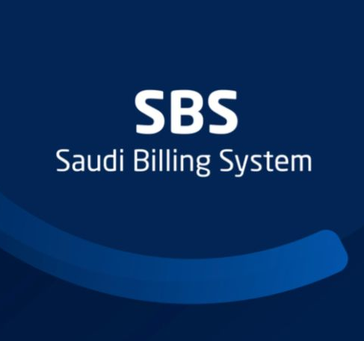




nphies: Integrating Global and Local Healthcare Standards
nphies leverages a comprehensive suite of international and Saudi clinical standards from various renowned sources to ensure accurate and efficient health information exchange.
Diagnosis & Disease Codes
Reporting Codes
Billing Codes
Classifying health conditions.
Standardizing data submission.
Facilitating financial transactions.

Slide 3
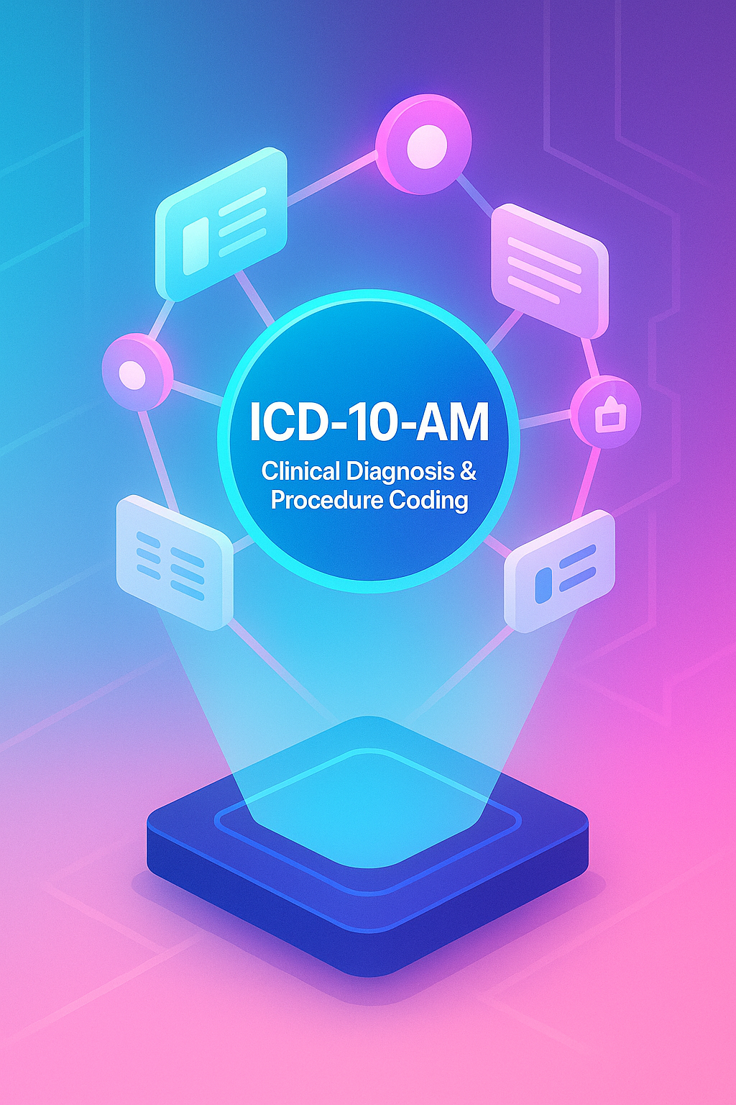
Diagnosis and Disease Related Codes
ICD-10-AM Diagnosis Codes
The 10th Edition of the Australian modification of WHO's ICD-10 codes, plus specific Australian disease codes, used for precise coding of diagnosed diseases and conditions.
ICD-10 Cause of Death and Morbidity (WHO)
Enables the translation of mortality and morbidity data into a standardized statistical format through accurate interpretation and recording of alpha-numeric ICD codes.
International Classification of Functioning, Disability, and Health (ICF)
A WHO framework designed for measuring health and disability at both individual and population levels, providing a comprehensive understanding of health states.
Urgency Related Groups (URG)
A specialized classification system utilized to categorize patient encounters within emergency departments, aiding in resource allocation and reporting.

Slide 4



Billing and Reporting Codes in nphies
Medical & Laboratory Reporting Code Systems
LOINC:
The preferred code set for laboratory test results and other clinical observations, facilitating seamless data exchange between healthcare facilities, labs, and public health authorities.
SNOMED-CT:
A comprehensive nomenclature of clinical terminologies used by healthcare providers for storage, retrieval, and electronic exchange of clinical records, ensuring consistency and accuracy.
Code Systems for Billing Services & Procedures
Saudi Billing System (SBS):
Developed by CHI and derived from the Australian ACHI coding system, SBS is a key billing and reporting system for medical procedures and services in Saudi Arabia.
Australian Refined Diagnosis Related Groups (AR-DRG) v9.0:
A classification system that groups hospital patients with similar conditions and resource needs, supporting Value-Based Healthcare (VBHC) by enhancing management in the Saudi health insurance market.

Slide 5
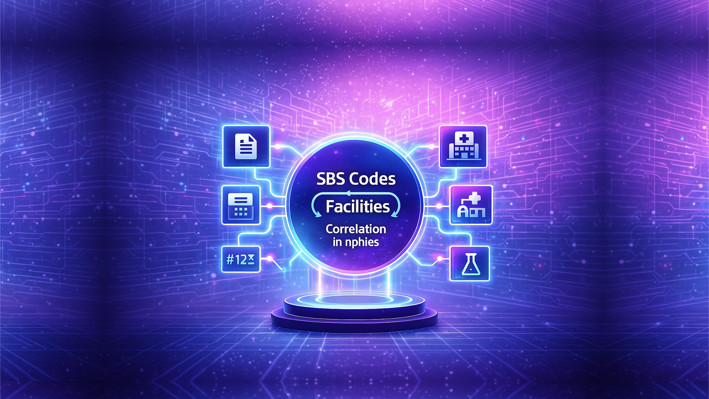


Correlation Between SBS Codes & Facilities in nphies
SBS Code Subdivision
SBS & Other Coding Systems Integration
SBS Codes are categorized into several billing systems including dental, inpatient, pharmacy, outpatient, and vision. This subdivision effectively limits the specific SBS codes that can be utilized by each facility type, streamlining billing processes.
nphies possesses robust capabilities to map SBS codes to other relevant coding systems. A prime example is the seamless mapping of SBS codes for HbA1C laboratory tests directly to LOINC codes and results, ensuring interoperability and data consistency.

